Slide 1
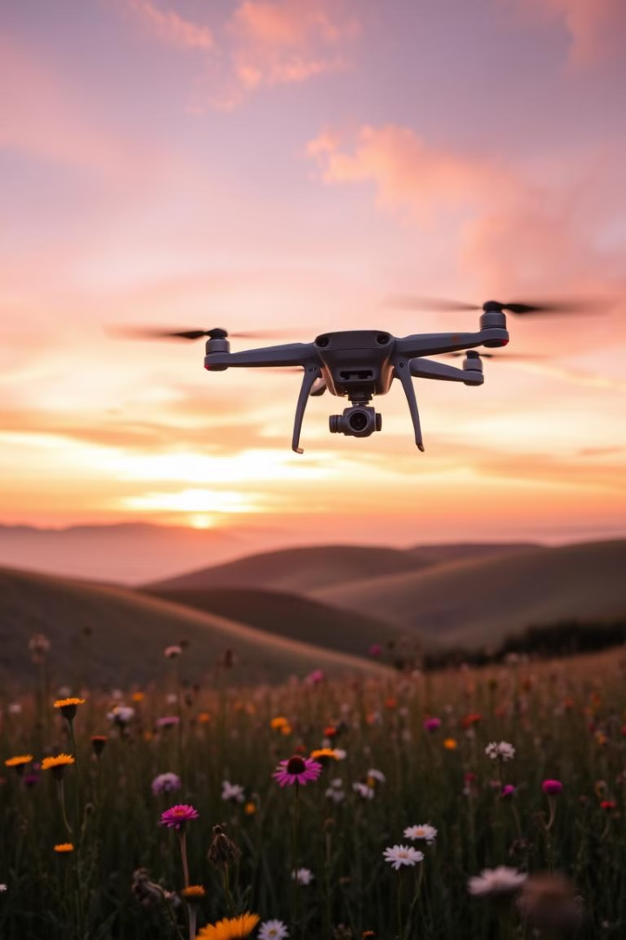
Drone Service Client Satisfaction Analysis
This presentation analyzes client satisfaction data for drone service projects from January to November 2023. It provides key insights into service performance, client satisfaction drivers, and areas for improvement.
AY
by Abdul-Musawwir Yunus

Slide 2
Executive Summary
Overall Satisfaction
Project Success
Client satisfaction averaged 4.55 out of 5.0, indicating a high level of customer satisfaction.
93% of projects were completed without technical issues, highlighting the reliability of the drone services.
Key Success Factors
Response time and image quality were identified as the most significant contributors to client satisfaction.

Slide 3
Data Overview & Methodology
Dataset Characteristics
Details
Projects Analyzed
30
Service Types
8
Client Industries
6
Metrics per Project
15

Slide 4
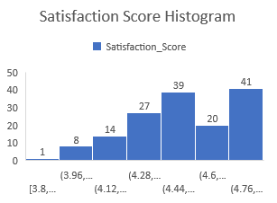
OVERALL
SATISFACTION
4.55
LOWEST
SATISFACTION SCORE
3.8
REPEAT RATE
75/150
HIGHEST SATISFACTION SCORE
4.9
ANALYSIS DASHBOARD
The analysis dashboard provides a comprehensive overview of key performance indicators, including client satisfaction scores, project completion rates, and revenue metrics.

Slide 5
KEY FINDINGS
1
Service Performance
2
Client Satisfaction Drivers
Wildlife Monitoring achieved the highest satisfaction rating, with an average score of 4.87 out of 5.0.
Response time, image quality, and communication rating had the strongest correlations with client satisfaction.

Slide 6
SERVICE TYPE ANALYSIS
Top Performing Services
Revenue Generation
Wildlife Monitoring
Site Mapping generated the highest average revenue per project, while Event Coverage had the lowest.
Aerial Photography
Agricultural Mapping

Slide 7


CORRELATION ANALYSIS
Project Cost & Satisfaction
A slight positive correlation (0.15) was observed between project cost and customer satisfaction.
Highest Rated Project
The most expensive project, costing $2,900, received a high satisfaction rating of 4.9/5.0.

Slide 8
TIME SERIES ANALYSIS
1
January
Initial client satisfaction scores were slightly lower, with an average of 4.4/5.0. November has the highest satisfaction score 4.65/5
2
February
Significant improvement in satisfaction scores, reaching an average of 4.6/5.0.
3
March
Continued high satisfaction levels, maintaining an average score of 4.7/5.0. Significant dips occurred in August and October

Slide 9

FUTURE DIRECTIONS
Further analysis can be conducted to explore specific factors within each service type, such as client industry, project complexity, and pilot experience.

Slide 10

CONCLUSION
The analysis reveals a high level of client satisfaction with the drone services. By focusing on key success factors like response time, image quality, and communication, the company can continue to deliver exceptional service and drive customer loyalty.

